Slide 1

National Basketball Association game result Prediction analysis
Arun Kumar Maram
Student ID: 11605850
ADTA-5940 Capstone Project

Slide 2

Introduction
The major objective of our research is to develop a trustworthy prediction model for NBA game outcomes. The idea behind this study is that by adding team Elo rankings, past performance information, and opponent Elo rankings to our prediction model, we may greatly increase our ability to forecast game results. This hypothesis highlights the significance of these variables as reliable indicators for interpreting the complex patterns found in NBA match results.

Slide 3
Research Questions
1. To build an accurate prediction for game outcomes (win/loss) using team Elo ratings, previous performance, and perhaps opposition Elo rankings?
2. To identify evidence of an 'away game disadvantage' in the NBA, can we analyze the progression of team Elo ratings in away games and identify teams who consistently perform better or worse when playing away from their home court?

Slide 4
Literature
Basketball teams compete at a high level. Winning teams usually outperform losing ones in defensive rebounds and field goal ability, underscoring the significance of smart decision-making and field goal ability for a team's success (Sun et al., 2022).
According to the study, players who started and those who didn't differ in defensive behaviors like fouls and rebounds, which may indicate that starters are more fit and have an effect on their play(Sampaio et al., 2010).
The research backs up the idea that defensive rebounds are essential for a team's effectiveness since they prevent opponents from scoring and create opportunities for successful offensive plays. It also highlights how crucial strategic decision-making and harmonious teamwork are to playing basketball effectively. The study also emphasizes the influence of familiarity, travel, and audience support, as well as the home-advantage effect(Gómez et al., 2008).
Extensive research across leagues and seasons is necessary to fully understand the significance of game-related statistics in basketball performance analysis, especially when identifying successful teams based on game location(Madarame, 2018 ).
Madarame, H. (2018, February 24). Defensive Rebounds Discriminate Winners from Losers in European but not in Asian Women’s Basketball Championships. Asian Journal of Sports Medicine, 9(1). https://doi.org/10.5812/asjsm.67428

Slide 5
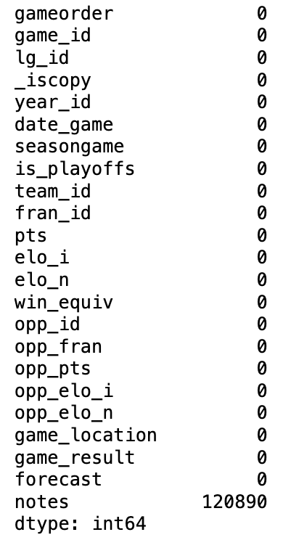
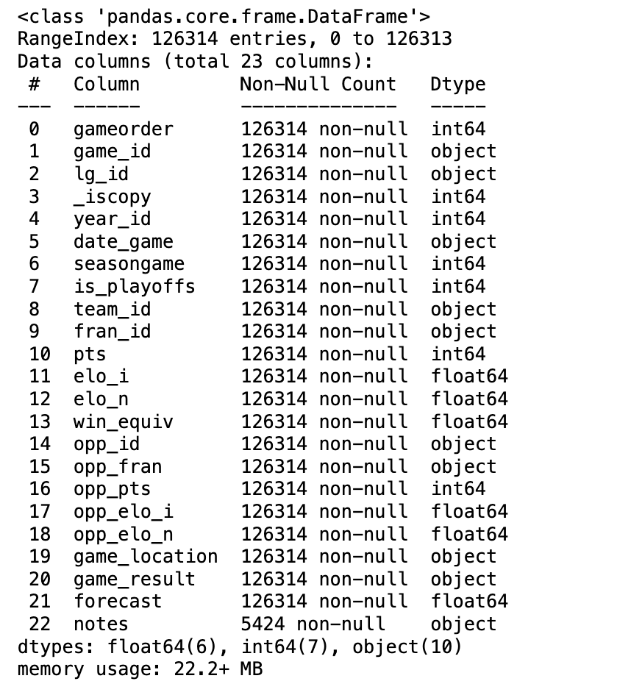
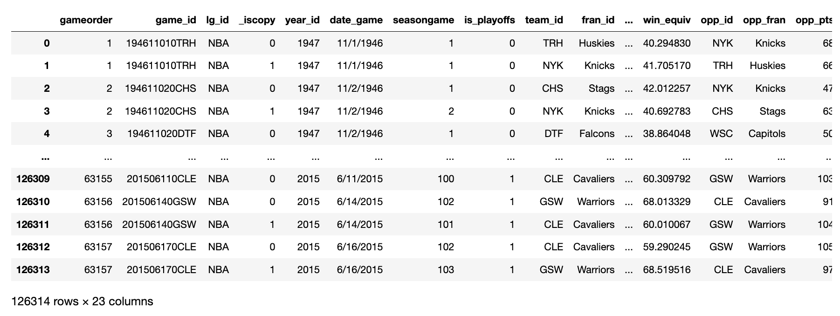
Dataset Description
The dataset is extensive, with information for every variable spread over 23 columns and 126313 records. As missing values might cause bias, this completeness ensures the validity of modeling and analysis. This thoroughness improves the accuracy and dependability of exploratory data analysis, enabling the confident investigation of connections and patterns.

Slide 6

Methods
Random Forest method
Chi-square Test
Logistic Regression

Slide 7

Weather Elo ratings effects the outcome of the game?
To see if the elo ratings effect the game result we conduct exploratory data analysis on the relevant columns and apply the modelling techniques.

Slide 8
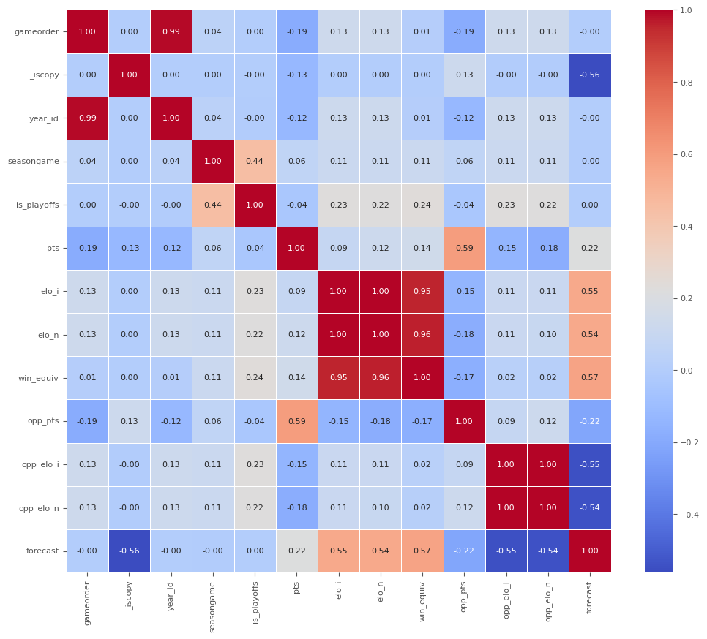
Correlation Analysis
The data shows a strong positive correlation between season year and NBA game order, with playoff games linked to higher team elo ratings, win equivalent values, and predicted winning chances. Teams with higher point totals typically have more victories in an 82-game season. Conversely, teams with higher win equivalents typically give up less points. The correlation matrix provides valuable insights into the dataset's connections.

Slide 9
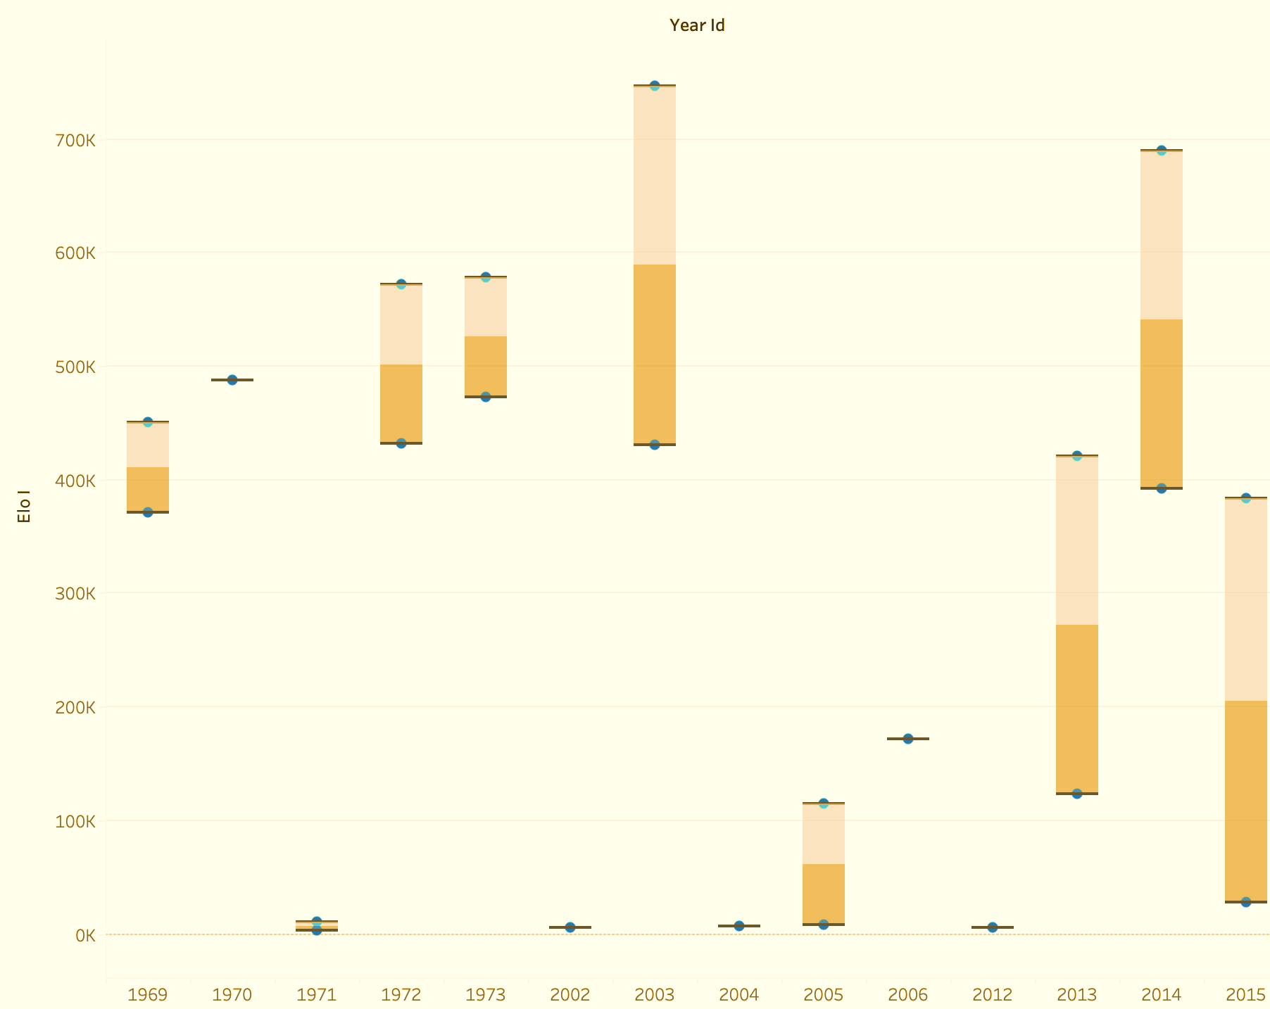
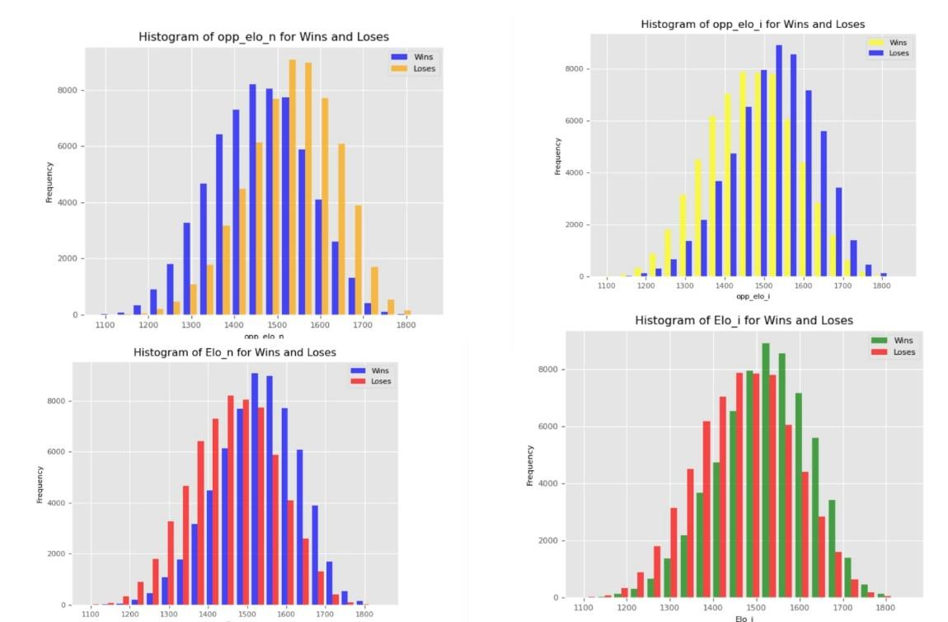
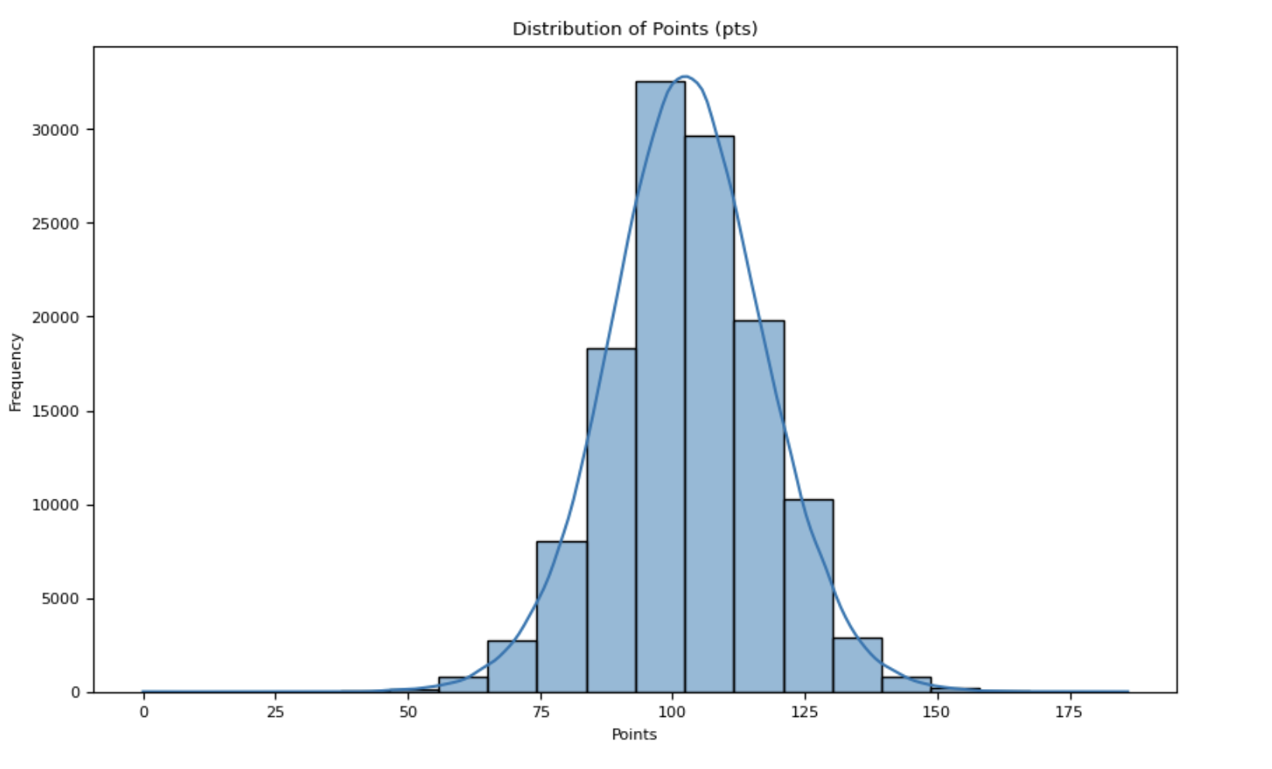
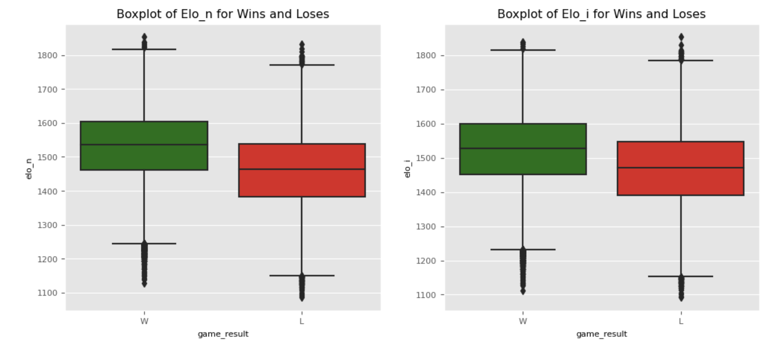
Exploratory Data Analysis
According to the data, there were noticeably more games in 2014 and 1972 than in other years. This could be because of modifications to the NBA seasons' schedule or structure.
Lower ratings are associated with more losses, while higher ratings are associated with more victories.
The boxplots, indicating a consistent trend in the changes in Elo ratings.

Slide 10
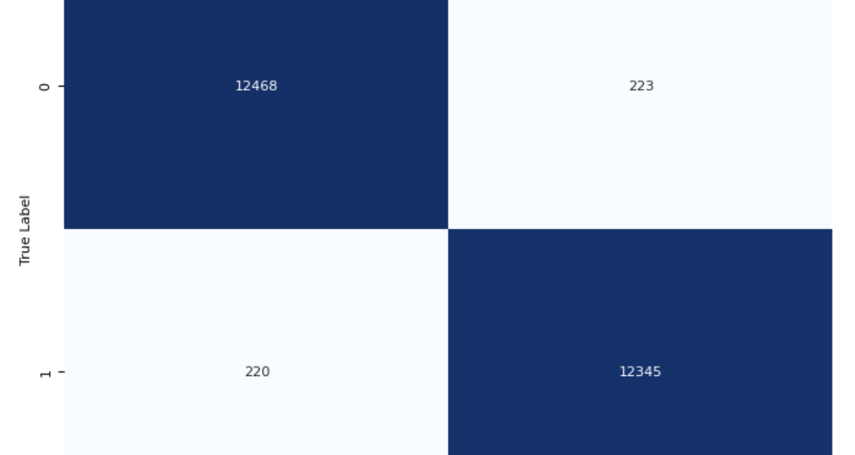
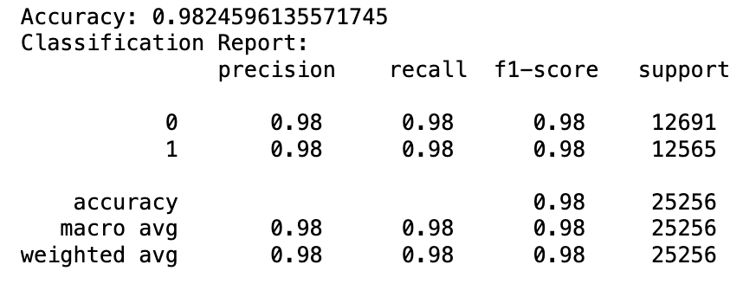
Random Forest Model
To fulfill the first research goal, whether elo ratings or past performance have an impact on game outcomes. Using the Elo ratings of the team, the opposition, and recent results, a random forest predicting model is created. The model's 98.25% accuracy rate shows how well it can forecast both winning and losing outcomes. The premise that Elo ratings and past performance have a large impact on game results is supported by the model's precision, recall, and F1-score measurements.

Slide 11

Will the game outcome depends on the Game location?
To see if the location of game effects the game result we conduct exploratory data analysis on the relevant columns and apply the modelling techniques.

Slide 12
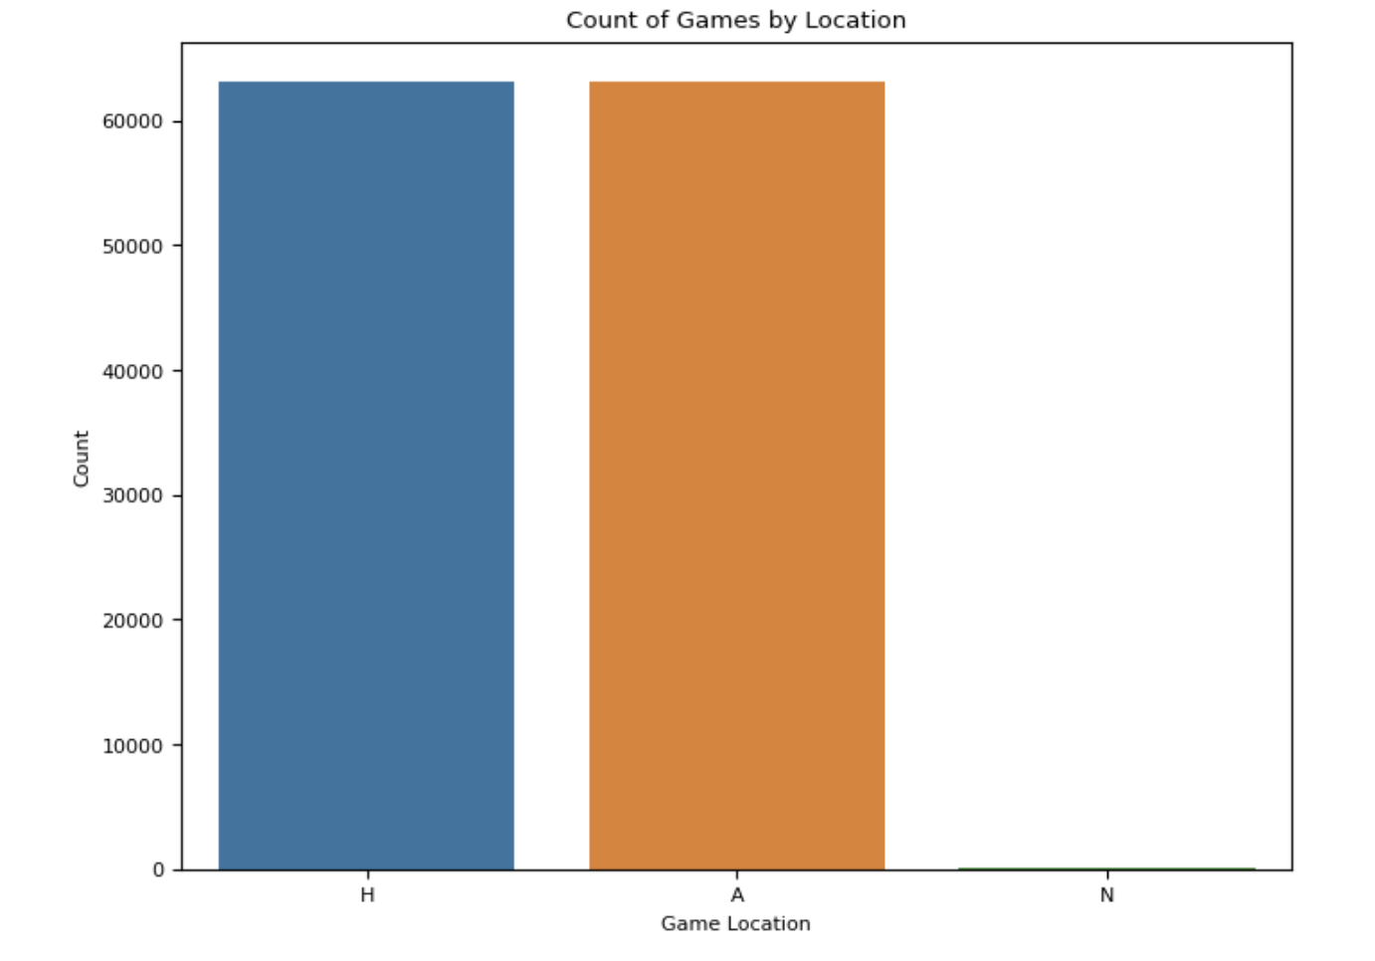
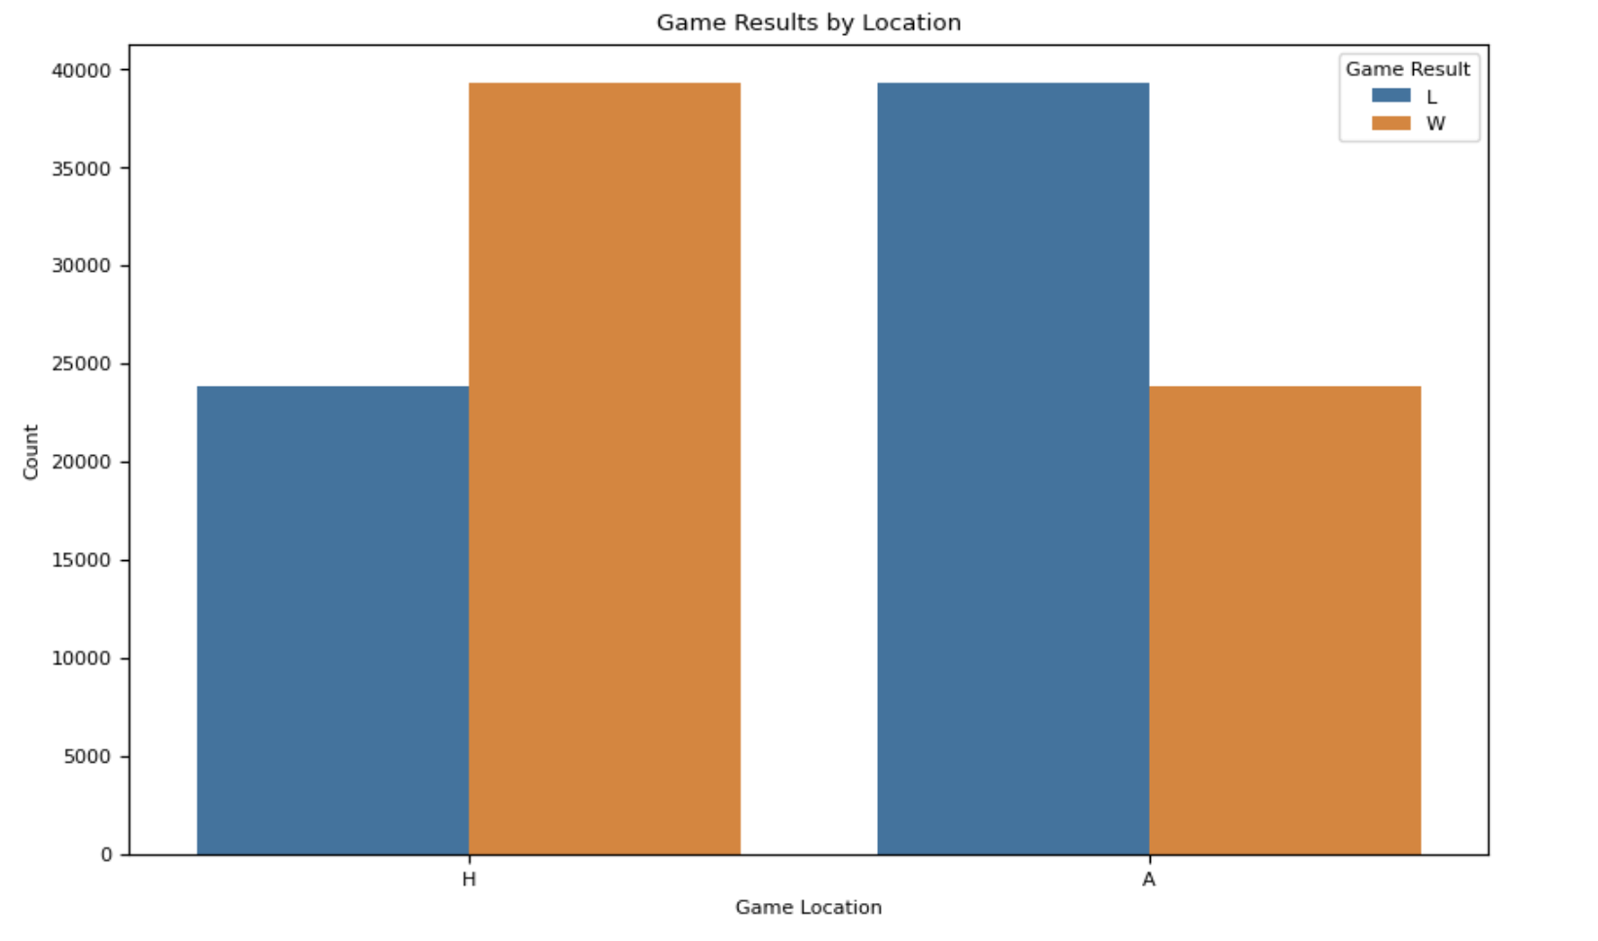
Exploratory Data Analysis
Approximately 60,000 games, evenly distributed between home and away locations, are included in the dataset. This balance lessens the impact of confounding variables and enhances statistical validity by assisting researchers in evaluating performance disparities and comparing outcomes across games. Determining the influence of game location is made easier by the uniformly distributed dispersion of games.
A bar graph makes it evident that home games tend to be more successful than away games. The disparity in bar heights suggests that teams generally perform better at home and emphasizes the significance of home-court advantage in the dataset by showing that more games were won there.

Slide 13
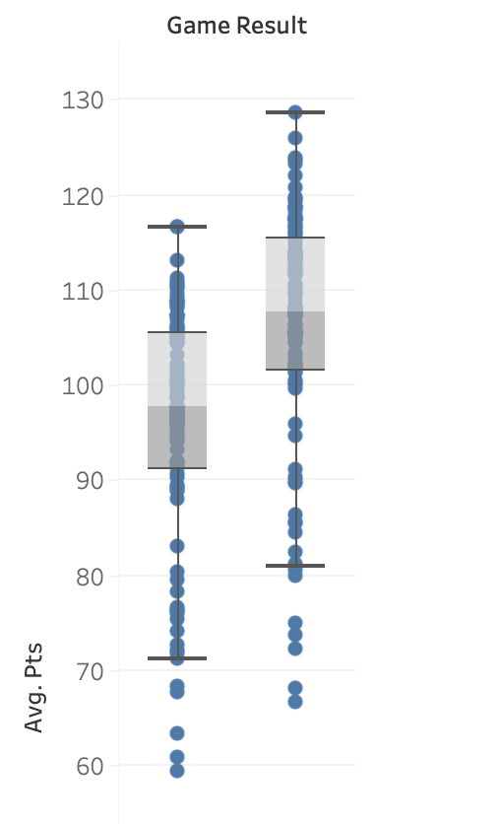
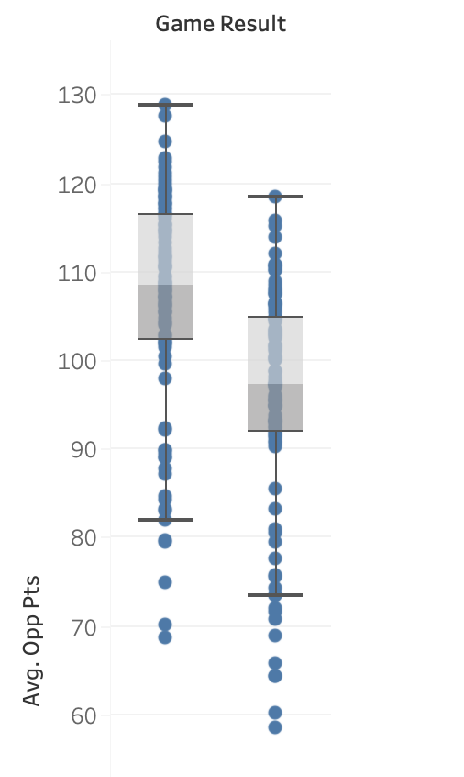
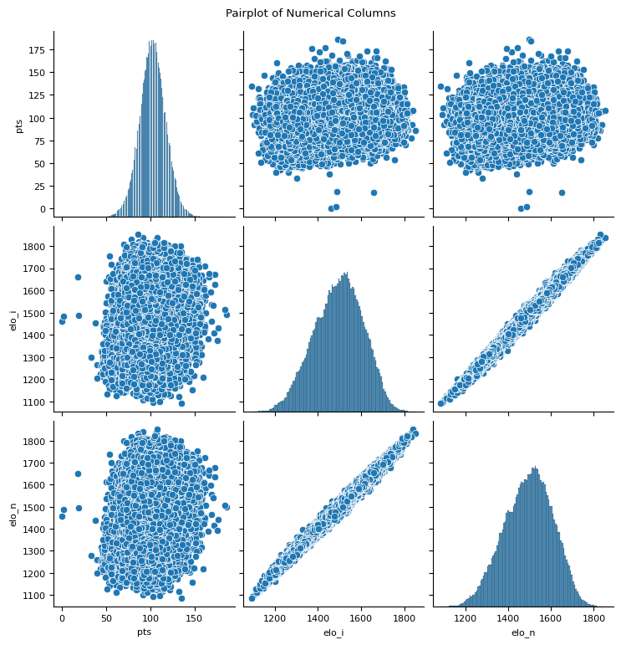
Exploratory Data Analysis
Distribution of numerical variables from the dataset is seen here.
The distribution of wins and losses for different teams was examined using a boxplot and line graph, which showed a home advantage. The line graph emphasized game differences, while the boxplot displayed summary data for each category. This thorough research emphasizes the superiority of home teams as well as any possible performance anomalies.

Slide 14
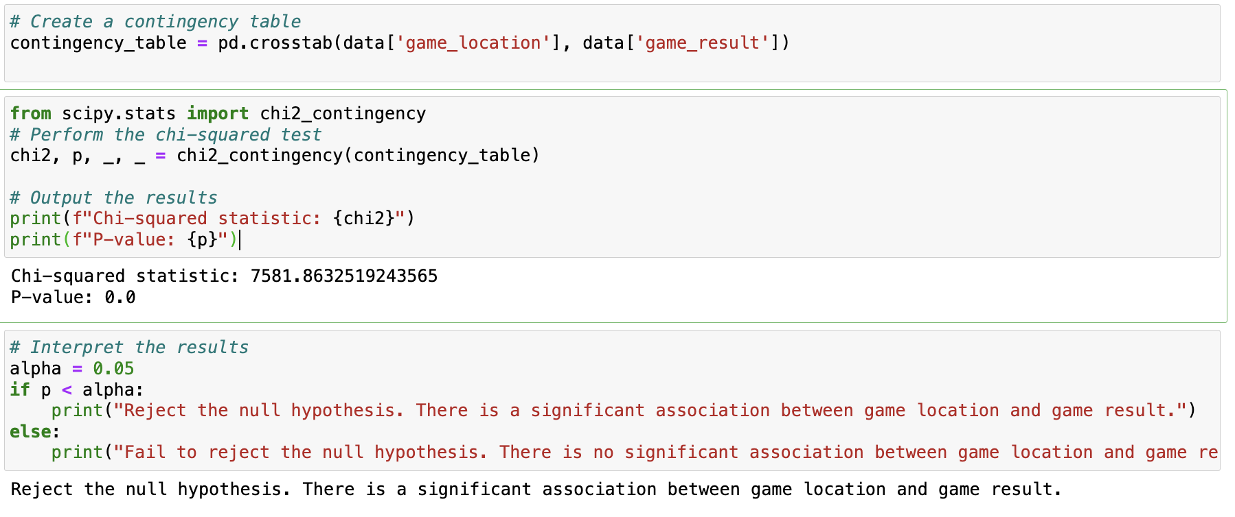
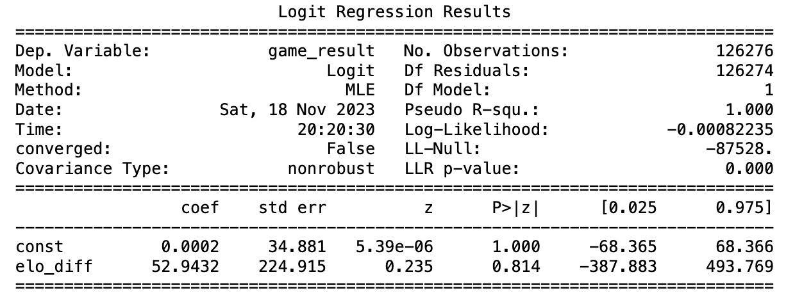
Chi-square Test
According to the Null Hypothesis (H0), there is no difference in the probability of winning or losing in home and away games. According to the Alternative Hypothesis (H1), there is a substantial relationship between the site of the game and its result, with venue-specific probability fluctuating. The goal of hypothesis testing is to support the alternative hypothesis and reject the null hypothesis.
Logistic regression
We evaluated the relationship between game_result and Elo ratings using logistic regression. The model suggesting that there was no statistically significant difference between the constant term and zero and no statistically significant coefficient of Elo_diff.

Slide 15

Results and Key Findings
Boxplot analysis offers important insights into the dynamics of team play by demonstrating regular changes in Elo ratings during games, independent of the result.
According to visualizations, a team's performance in NBA games is greatly impacted by home-court advantage, with home games having a greater distribution of victories than away games.
The study highlighted the significance of game location in NBA game results by finding a substantial association between game location (home or away) and outcome (win or lose).

Slide 16
Results and Key Findings
With peaks in 1972 and 2014, the distribution of NBA games underwent notable shifts throughout time, possibly as a result of modifications to league-related events, season schedules, or formats.
The random forest model demonstrated 98.25% accuracy in predicting NBA game outcomes, highlighting the significance of Elo ratings, historical performance metrics, and rival Elo rankings.
Despite offering insights into Elo ratings and game outcomes, the logistic regression model had difficulties with convergence, indicating that additional study or model revisions could enhance its dependability.

Slide 17

Conclusion
The study underscores the significance of home-court advantage in basketball by emphasizing the predictive relationship between game location, crowd support, team camaraderie, and familiarity with the surroundings.
According to the research, a predictive model can enhance game projections, evaluate the strengths and weaknesses of a team, and direct strategic decisions while offering insightful information about psychology and performance.
For better predictive modeling in professional basketball, the paper recommends further research on the dynamics of Elo ratings, player-level data, external variables, dataset extension, and cutting-edge machine learning techniques.
The research suggests expanding the study beyond 1946-1947 to analyze NBA long-term trends, rule changes, and league expansions, improving the predictive model's adaptability to evolving NBA dynamics.
With an accuracy of 98.25%, the study confirms a prediction model for NBA game results. While acknowledging the need for additional research and model improvements, it integrates team Elo ratings and historical performance data.

Slide 18

References
Sun, W., Chee, C., Kok, L., Lim, F., & Samsudin, S. (2022, November 25). Evaluation of differences in the performance strategies of top and bottom basketball teams utilizing rank-sum ratio comprehensive. Frontiers in Sports and Active Living, 4. https://doi.org/10.3389/fspor.2022.1052909
Sampaio, J., Drinkwater, E. J., & Leite, N. M. (2010, March). Effects of season period, team quality, and playing time on basketball players’ game-related statistics. European Journal of Sport Science, 10(2), 141–149. https://doi.org/10.1080/17461390903311935
Gómez, M. A., Lorenzo, A., Barakat, R., Ortega, E., & José M., P. (2008, February). Differences in Game-Related Statistics of Basketball Performance by Game Location for Men’s Winning and Losing Teams. Perceptual and Motor Skills, 106(1), 43–50. https://doi.org/10.2466/pms.106.1.43-50

